Slide 1
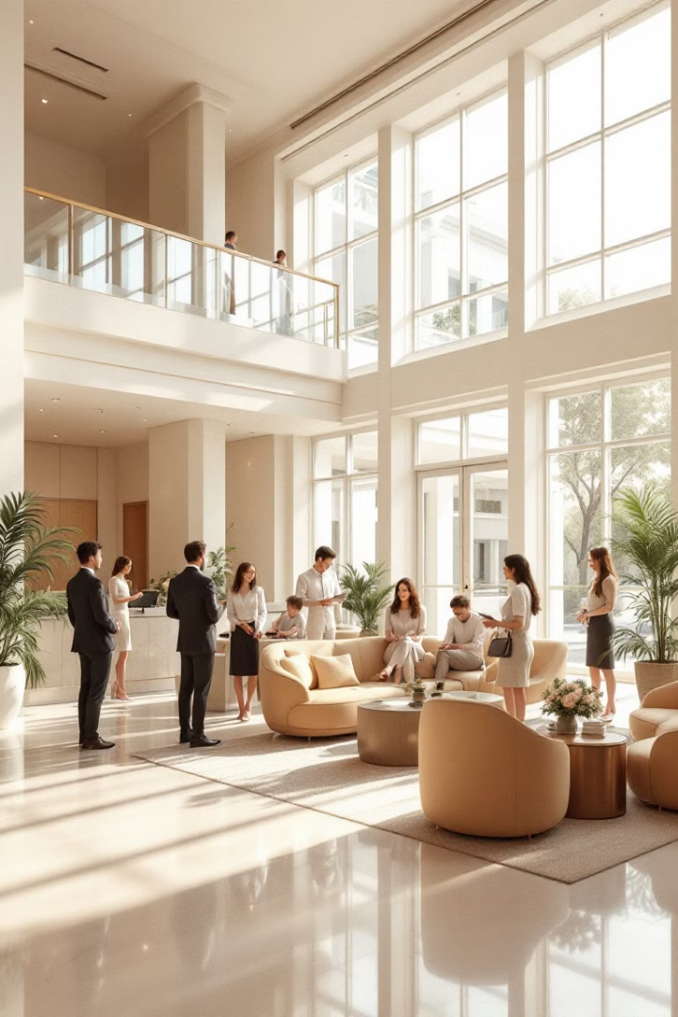
EasyStay: Revolutionizing Hotel Management
EasyStay is a comprehensive hotel management system designed to enhance guest experience, streamline operations, and boost efficiency for hotels of all sizes. Discover how EasyStay can transform your hotel's performance.

Slide 2

Problem Statement
Hotels face a growing challenge: meeting rising guest expectations while maintaining operational efficiency. Guests demand a seamless digital experience, from online booking to contactless check-in, while hotels need to streamline internal processes, manage costs, and ensure staff satisfaction. EasyStay recognizes this complex landscape and offers a tailored solution.

Slide 3
Enterprises
Transportation
1
Supports vehicle bookings for airport transfers, local travel, and customized guest transportation services.
2
Recreation/Enjoyments
Gaming Facility: Offers access to gaming areas, such as arcades or board games.
Food & Beverages
3
Pool Facility: Manages pool usage, slot reservations.
Enables guests to access a digital menu and order meals for in-room dining or restaurant service.
4
Home keeping
Laundry Facility: Manages guest laundry requests and delivery.
Room Cleaning: Oversees room cleaning and common area maintenance.
Shopping
5
Provides an in-house shopping platform where guests can browse and order products for room delivery.

Slide 4
Organizations
Vehicle Bookings
Gaming Facility
Manages guest transportation requests, ensuring timely bookings and vehicle availability. Guests select from various vehicle types (cars, vans, shuttles). The platform manages schedules and driver assignments for efficient service.
Handles guest reservations and ensures smooth recreational activity operation. The platform manages reservations, equipment rentals, and staffing schedules, offering arcade games, table games, and VR experiences.
Pool Facility
Food Services
Oversees pool scheduling, safety compliance, and cleanliness. It manages pool hours and reservation systems, ensuring proper sanitation, maintenance, and lifeguard availability.
Manages food and beverage orders from preparation to delivery. Guests order meals, snacks, and drinks via the platform, which manages menus, orders, and delivery schedules.
Laundry Services
Room Cleaning
Handles laundry requests and delivers clean items to guest rooms. The platform manages inventory, processing schedules, and delivery logistics for a seamless experience.
Manages cleaning schedules and assigns tasks to janitorial staff for timely service. The platform tracks room status, assigns tasks, and ensures high cleanliness standards and guest satisfaction.
In-House Shop
Parking Facility
Manages inventory and operations of the hotel's in-house shopping services. Guests purchase various products (souvenirs to daily essentials). The platform handles inventory, orders, and delivery.
Oversees parking space allocation for guests. The platform manages parking reservations, monitors availability, and ensures efficient utilization of parking facilities.

Slide 5
Roles and Responsibilities
Hotel Admin
Customer
Oversees the entire system, including user and staff management, janitor task assignment, and operational insights through analytics.
Accesses the platform to book services, track requests, and share feedback.
Vehicle Contractor
Gaming In-Charge
Updates the fleet of vehicles and manages transportation requests.
Maintains gaming facilities by adding new games and handling reservations.
Pool In-Charge
Food Manager
Updates pool availability, ensures smooth booking processes, and manages safety.
Curates the food menu, supervises preparation, and processes guest food requests.
Laundry Manager
Janitor
Handles inventory for laundry services and ensures timely processing of requests.
Keeps the premises clean by addressing room cleaning and maintenance needs.
Shopping Manager
Parking Manager
Oversees the in-house store, adds products, and fulfills customer orders.
Organizes parking spaces, adds new slots, and coordinates booking approvals.

Slide 6
Features of the Platform
Digital Service Requests
1
Guests can request services such as room cleaning, laundry, or food orders via the app.
2
Role-Based Dashboards
Staff members have dedicated dashboards tailored to their responsibilities.
Real-Time Updates
3
Guests and staff receive updates on request statuses, ensuring transparency and efficiency.
4
Operational Analytics
Admins access reports on service usage analytics.

Slide 7

Advanced Features
Google Maps Integration
Email Notification System
Customers can select a pickup location for vehicles directly on the map during booking, enhancing location accuracy and improving user experience.
Automatically notifies customers via email when their booking is approved or rejected by the manager, keeping users informed and ensuring seamless communication.

Slide 8
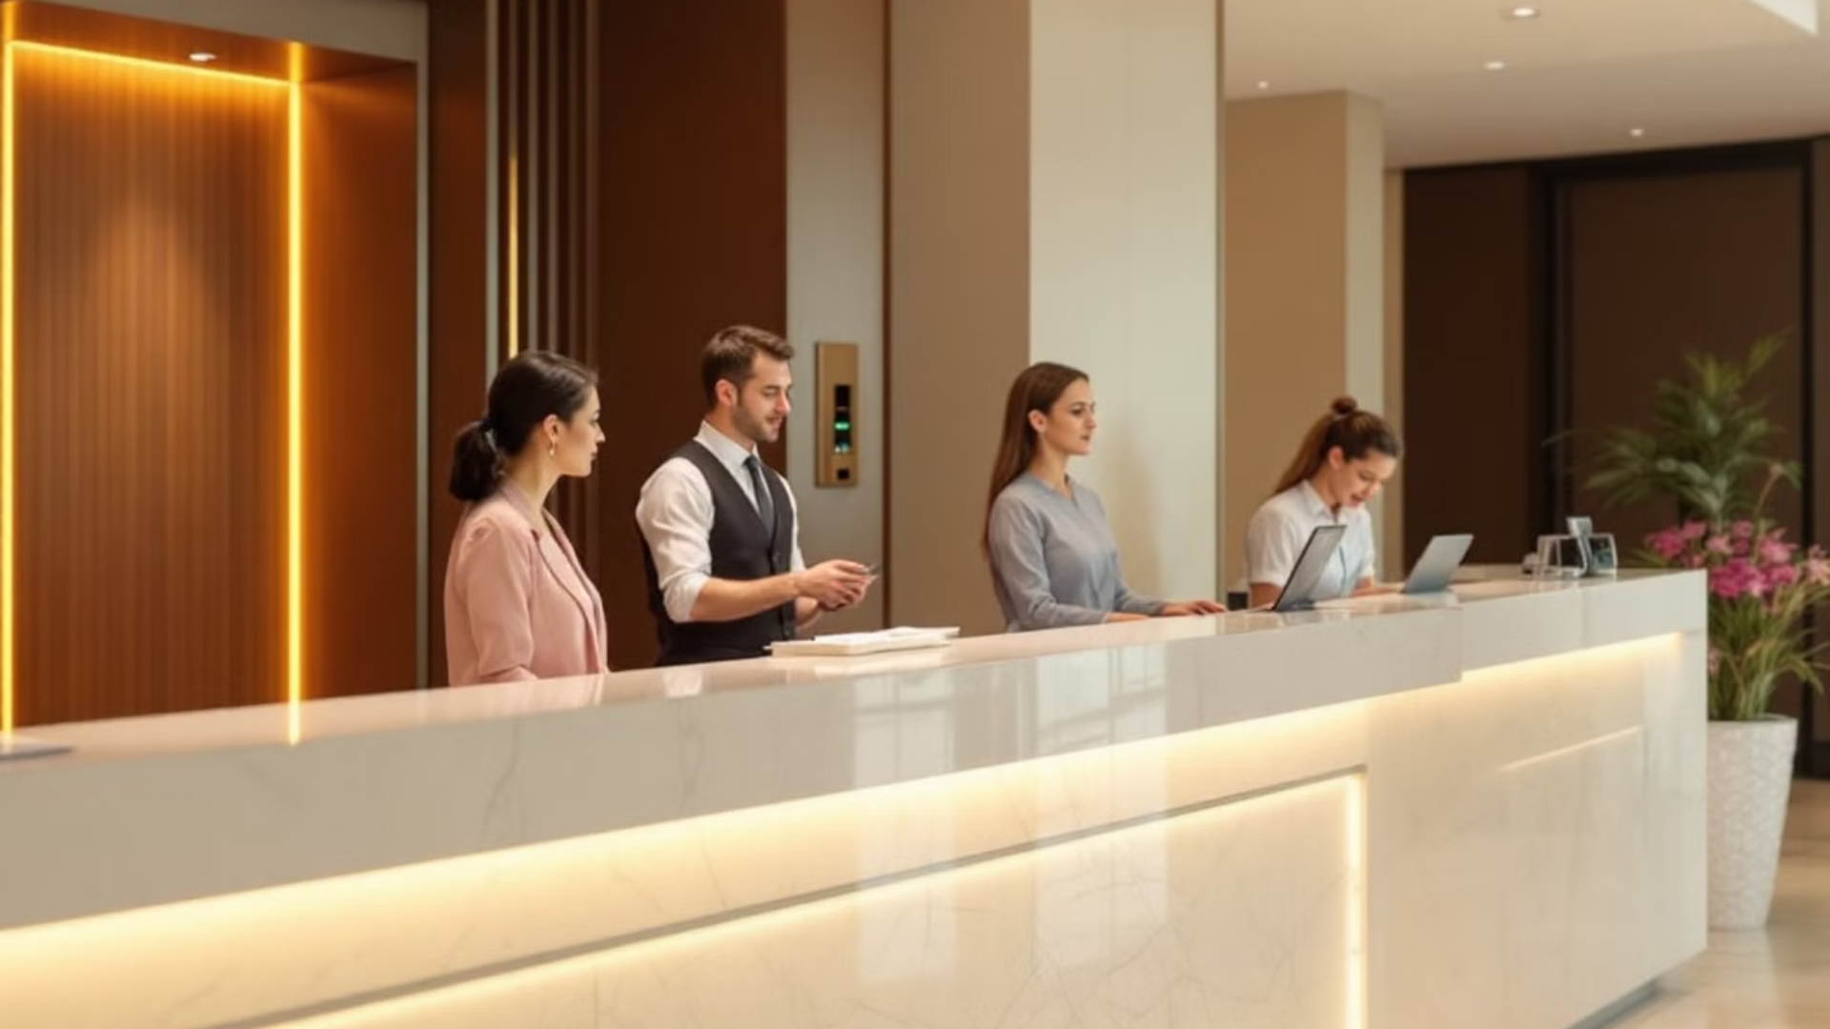
Cross Requests Implementation
Cross-Enterprise Request
Cross-Organization Request
Between Housekeeping (Laundry) and Recreation (Pool): A towel and clothes request is sent to ensure seamless coordination across two different enterprise domains.
Between Parking Facility Management and Vehicle Booking Organization: A parking request is sent to allocate spaces for vehicles booked through the system, ensuring smooth collaboration within the hotel organization.

Slide 9

Thank You!
We are Group 10.
1
RAHUL PATIL (002308778)
2
KANISHK SINGH (002052790)
3
RUSHANG DALAL (002053714)
4
SUSHANT JOSHI (002322090)

